Slide 1

Fifa Player Value ML Analysis Presentation

Slide 2
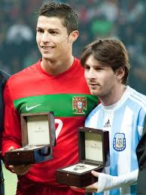
Question: Ability of Soccer players – Who is the Best for their Buck?
What statistics really determine a players true market Value?
Which players are worth investing into based on their current value and potential for growth?

Slide 3
Why This Specific Topic?
We understand that teams are good as a whole and if players are taking resources from a team, the whole team suffers as a whole
This brings the question what truly determines a players Value and worth? What statistical categories are responsible for determining a players true market value and worth?
This would be of interest to many parties including the club teams that players are signed by as if there is a potential for a player to be signed based off of their market value growing, teams may want to invest in those players vs players who may be over-valued

Slide 4
Source of our Data
The source of our data is a CSV file with over 17,000 rows of players
There were originally over 90 columns of data and statistical measures for each player from which we needed to determine which columns would be important and needed in our Machine Learning Model
As this is a large dataset it was important for us to determine which columns will not be needed for our analysis and we will further discuss this in our data exploration phase

Slide 5

Questions We Want to Answer
The main Question we want to answer is what determines a player’s market value?
Other questions which will be important to answering this question is which statistical categories are most relevant in determining a players market value?
Additional minor questions that could be a possibility are, do certain teams add value to a player? Are players of certain countries more marketable than others? These are all questions we could look into for our analysis

Slide 6
Data Exploration Phase
Looking through our dataset we noticed there were many columns that were duplicates which would be redundant in our analysis which we decided to remove
We also noticed that in certain statistical categories players were being measured for a position they wouldn’t be playing (forwards being measured for goalkeeper reflexes, goalies being measured for shooting ability etc.)
Another thing to take into consideration is that the outlier players who have huge market values such as a Messi and Ronaldo who’s data would not be ideal to measure in our ML analysis as regardless of their statistics their market value is also determined by external factors (sponsorship deals amongst many marketing techniques)

Slide 7
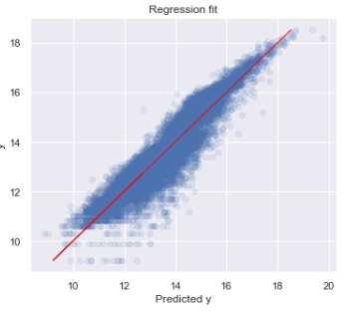
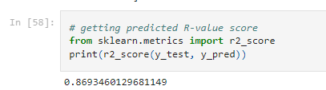
Analysis Phase
When we finally determined which information was important and necessary to our machine learning analysis we dropped these columns and started to create our machine learning model. The model Accuracy once complete came up with an Accuracy of 86%

Slide 8
Technologies, Languages, Tools Used in our Project
For our Analysis of our Data and the Machine learning model we used Python
For Visualizations for our dashboard we used Tableau
For our database we used Postgres SQL to query and create our tables and create a final table which was determined by the machine learning model

Slide 9
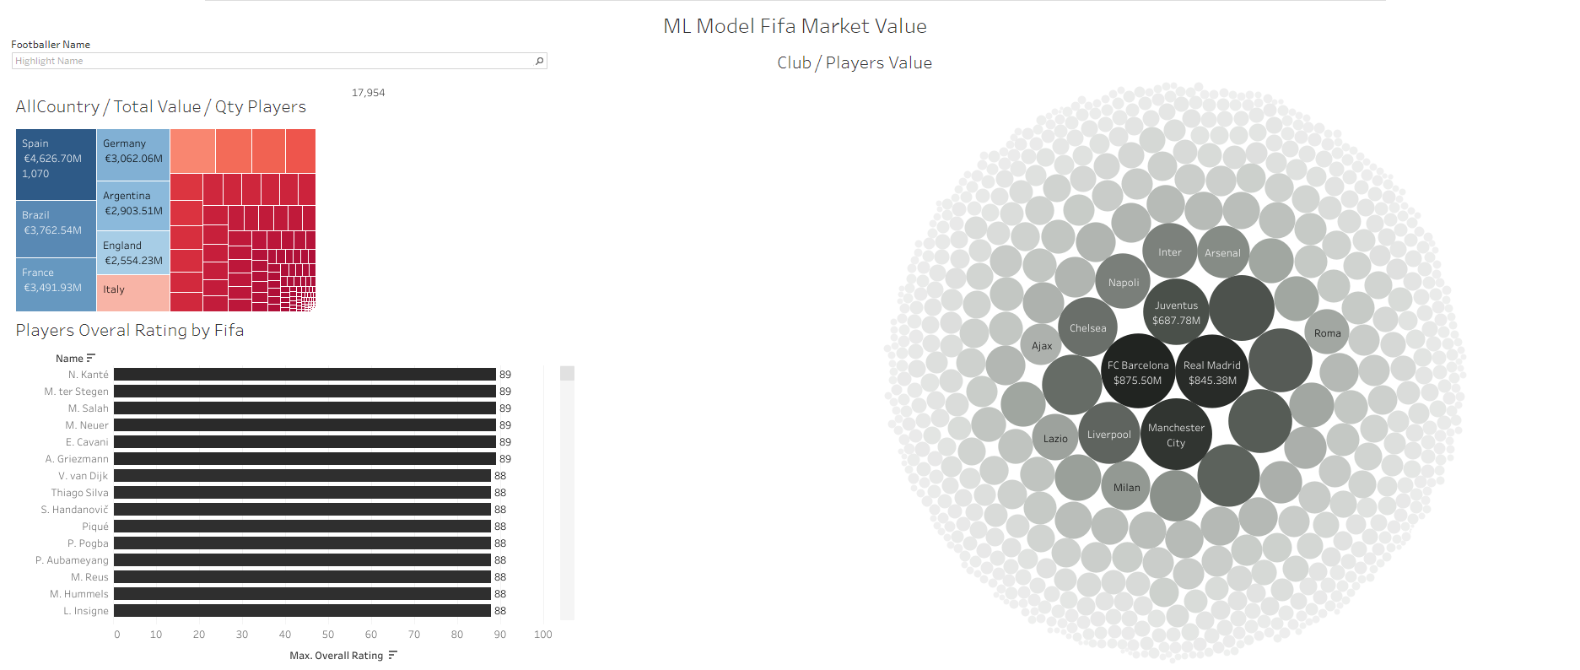
Dashboard
Type player name
Select player country
This diagram will display results based on selected player information (player name, country)

